Slide 1
1.Introduction
Computer Architecture

Slide 2
Executive Summary
Motivation: Computer Architecture studies and proposes novel system architectures using both low- and high-level analysis.
Problem: Computing systems technology is continuously evolving and software trends are constantly changing.
Overview:
- CS3051 course logistics.
- Computer Architecture Introduction and show abstraction levels.
- Review of number representation and data types.
Conclusion: Computer Architecture provides insight of the processor design paradigm to propose next-gen designs and allows the designer to create efficient software.
CS3051-COMPUTER ARCHITECTURE

Slide 3

Msc. Carlos Williams Valencia
cwilliams@utec.edu.pe
Lecturer
Department of Computer Science
He has a master's degree in Nanophysics from the Freie
Universität Berlin (Germany) and the École Polytechnique
(France). He has completed internships in different institutions and companies (INICTEL-UNI, STMicroelectronics and EPFL) where he has obtained extensive experience in semiconductor physics, optics and device design. His current research interests focus on photonics, design optimization and nanophysics.

Slide 4
Outline
Introduction
Data Representation
Floating Point
Conclusions
CS3051-COMPUTER ARCHITECTURE

Slide 5
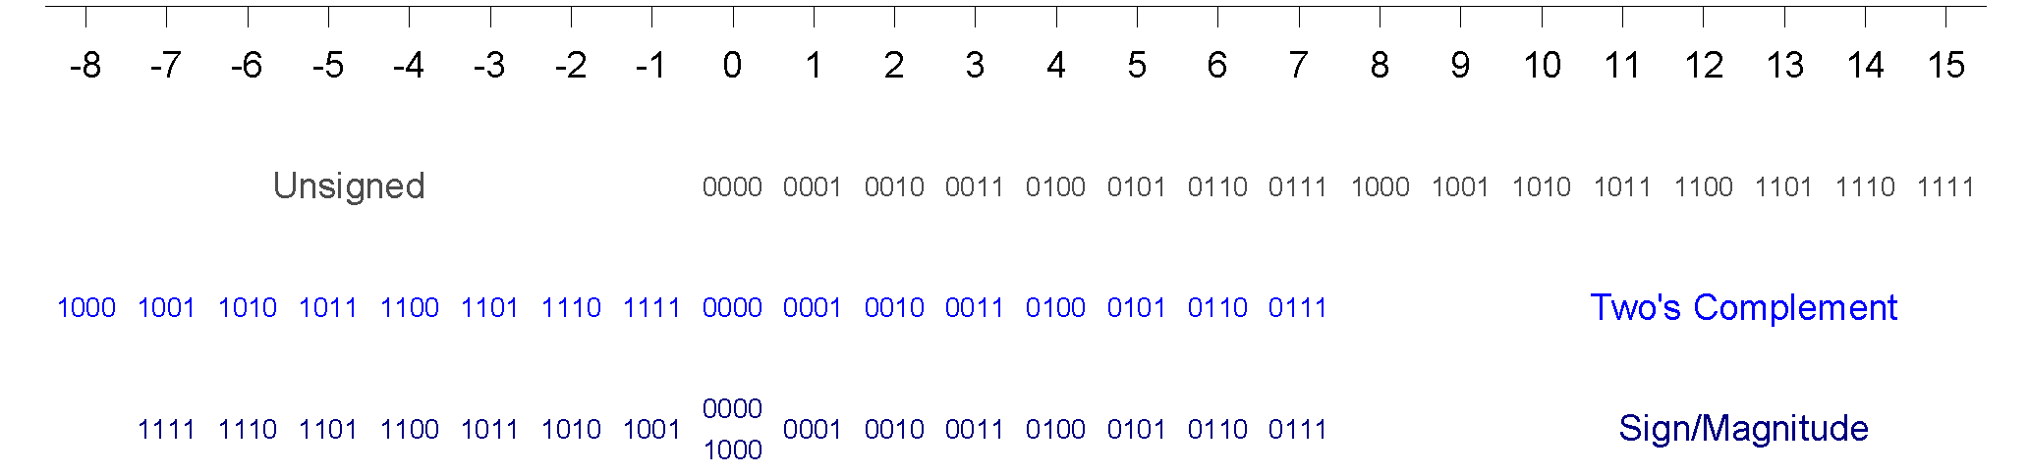
Recall:Binary Representation Summary
Number System | Range
Unsigned | [0, 2^{N}-1]
Sign-magnitude | [-(2^{N-1}-1), 2^{N-1}-1]
Two’s Complement | [-2^{N-1}, 2^{N-1}-1]
Example, 4-bit representation:
CS3051-COMPUTER ARCHITECTURE

Slide 6
Recall: Example Data Representations (Bytes)
IEEE 754 standard
C Data Type | Typical 32-bit | Typical 64-bit
char | 1 | 1
short | 2 | 2
int | 4 | 4
long | 4 | 8
float | 4 | 4
double | 8 | 8
long double | − | −
pointer | 4 | 8

Slide 7
Outline
Introduction
Data Representation
Floating Point
Conclusions
CS3051-COMPUTER ARCHITECTURE

Slide 8
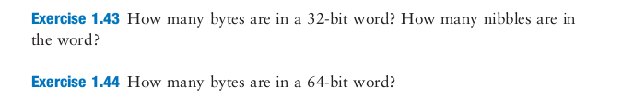

Slide 9
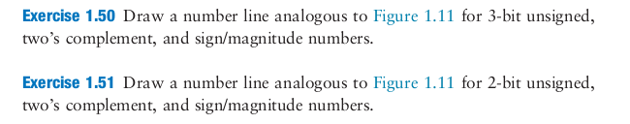

Slide 10
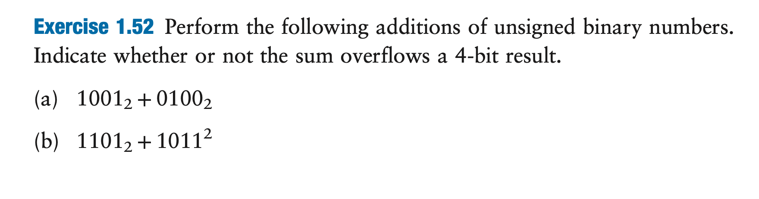
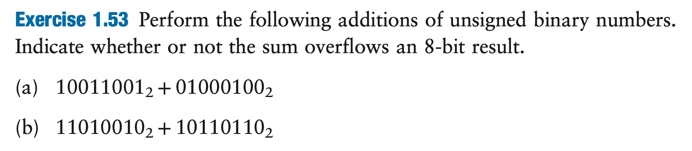

Slide 11
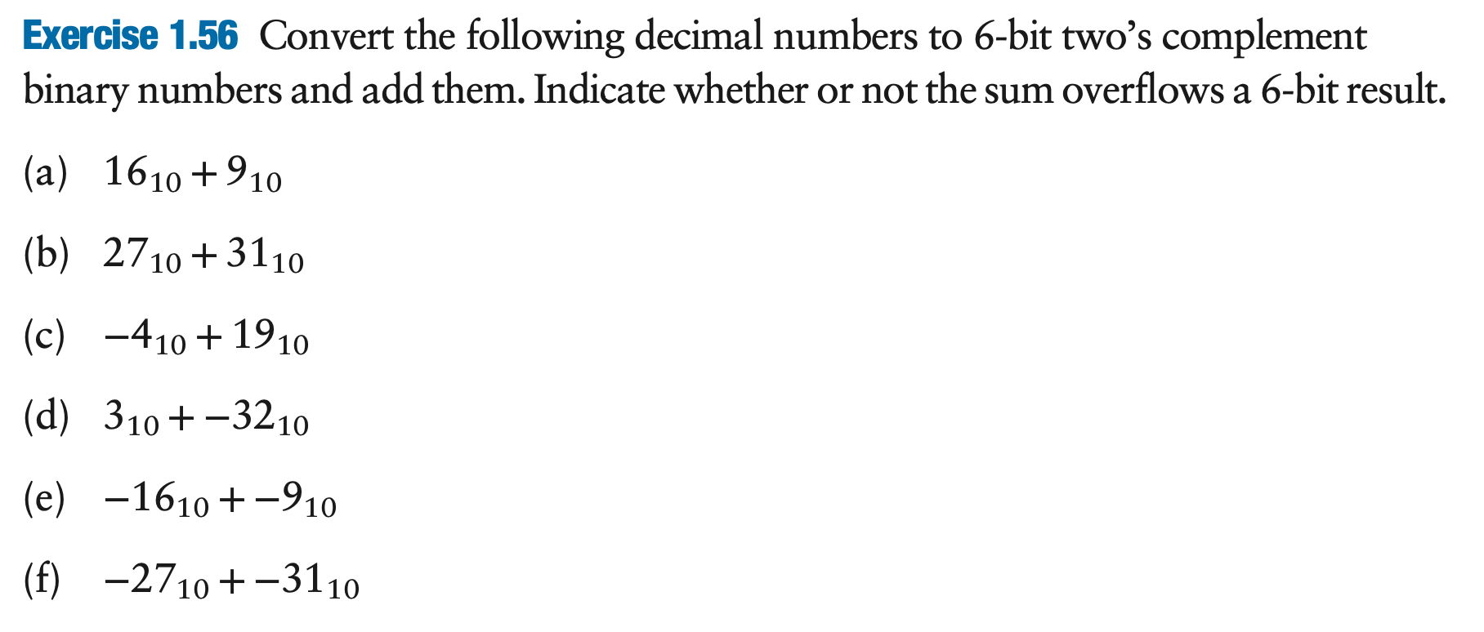

Slide 12
Outline
Introduction
Data Representation
Floating Point
Conclusions
CS3051-COMPUTER ARCHITECTURE

Slide 13
Floating-Point Format
Representation for non-integral numbers
Including very small and very large numbers
Like scientific notation
–2.34 × 10⁵⁶
+0.002 × 10^{–4}
+987.02 × 10⁹
In binary
±1.xxxxxxx₂ × 2^{yyyy}
Types float and double in C
normalized
not normalized

Slide 14
Floating-Point Standard
Defined by IEEE Std 754-1985
Developed in response to divergence of representations
Portability issues for scientific code
Now almost universally adopted
Two representations
Single precision (32-bit)
Double precision (64-bit)

Slide 15
IEEE Floating-Point Format
single: 8 bits double: 11 bits
single: 23 bits double: 52 bits
S
Exponent
Fraction
S: sign bit (0 ⇒ non-negative, 1 ⇒ negative)
Normalized significand: 1.0 ≤ |significand| < 2.0
Always has a leading pre-binary-point 1 bit, so no need to represent it explicitly (hidden bit)
Significand is Fraction with the “1.” restored
Exponent: excess representation: actual exponent + Bias
Ensures exponent is unsigned
Single: Bias = 127; Double: Bias = 1203

Slide 16
Single-Precision Range
Exponents 00000000 and 11111111 reserved
Smallest value
Exponent: 00000001 ⇒ actual exponent = 1 – 127 = –126
Fraction: 000…00 ⇒ significand = 1.0
±1.0 × 2^{–126} ≈ ±1.2 × 10^{–38}
Largest value
exponent: 11111110 ⇒ actual exponent = 254 – 127 = +127
Fraction: 111…11 ⇒ significand ≈ 2.0
±2.0 × 2⁺¹²⁷ ≈ ±3.4 × 10⁺³⁸

Slide 17
Double-Precision Range
Exponents 0000…00 and 1111…11 reserved
Smallest value
Exponent: 00000000001 ⇒ actual exponent = 1 – 1023 = –1022
Fraction: 000…00 ⇒ significand = 1.0
±1.0 × 2^{–1022} ≈ ±2.2 × 10^{–308}
Largest value
Exponent: 11111111110 ⇒ actual exponent = 2046 – 1023 = +1023
Fraction: 111…11 ⇒ significand ≈ 2.0
±2.0 × 2⁺¹⁰²³ ≈ ±1.8 × 10⁺³⁰⁸

Slide 18
Floating-Point Precision
Relative precision
all fraction bits are significant
Single: approx 2^{–23}
Equivalent to 23 × log₁₀2 ≈ 23 × 0.3 ≈ 6 decimal digits of precision
Double: approx 2^{–52}
Equivalent to 52 × log₁₀2 ≈ 52 × 0.3 ≈ 16 decimal digits of precision

Slide 19
Floating-Point Example
Represent –0.75
–0.75 = (–1)¹ × 1.1₂ × 2^{–1}
S = 1
Fraction = 1000…00₂
Exponent = –1 + Bias
Single: –1 + 127 = 126 = 01111110₂
Double: –1 + 1023 = 1022 = 01111111110₂
Single: 1011111101000…00
Double: 1011111111101000…00

Slide 20
Floating-Point Example
What number is represented by the single-precision float 11000000101000…00
S = 1
Fraction = 01000…00₂
Fxponent = 10000001₂ = 129
x = (–1)¹ × (1 + 01₂) × 2^{(129 – 127)}
= (–1) × 1.25 × 2²
= –5.0

Slide 21
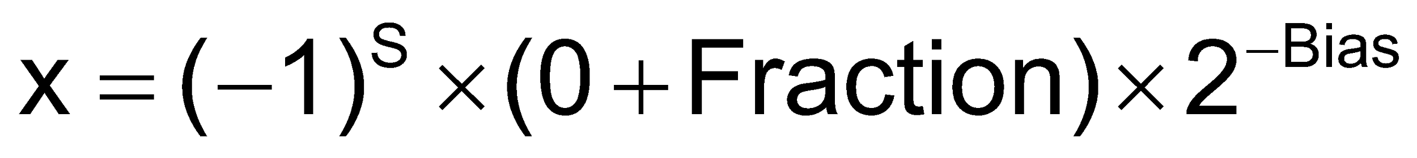
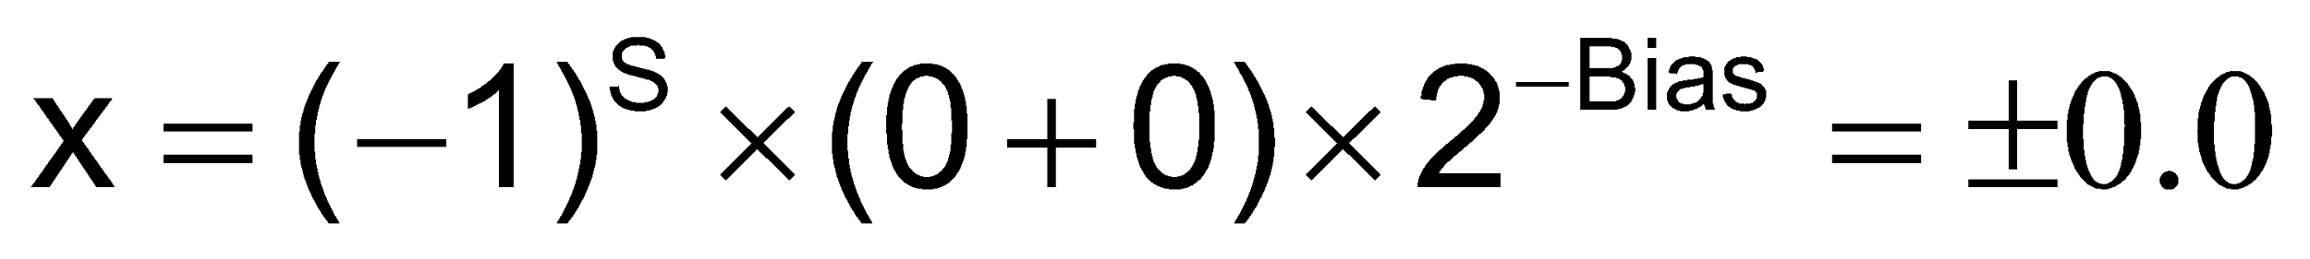
Denormal Numbers
Exponent = 000...0 ⇒ hidden bit is 0
Smaller than normal numbers
allow for gradual underflow, with diminishing precision
Denormal with fraction = 000...0
Two representations of 0.0!

Slide 22
Infinities and NaNs
Exponent = 111...1, Fraction = 000...0
±Infinity
Can be used in subsequent calculations, avoiding need for overflow check
Exponent = 111...1, Fraction ≠ 000...0
Not-a-Number (NaN)
Indicates illegal or undefined result
e.g., 0.0 / 0.0
Can be used in subsequent calculations

Slide 23
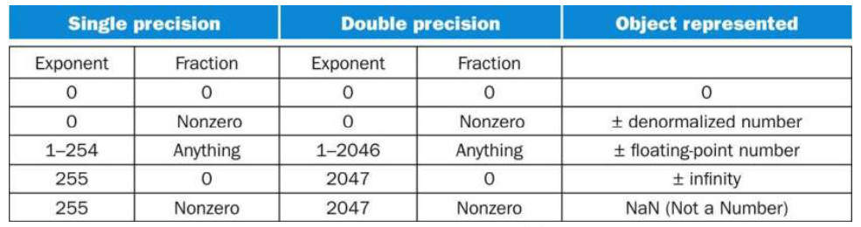
Special Values

Slide 24
Floating-Point Addition
Consider a 4-digit decimal example
9.999 × 10¹ + 1.610 × 10^{–1}
1. Align decimal points
Shift number with smaller exponent
9.999 × 10¹ + 0.016 × 10¹
2. Add significands
9.999 × 10¹ + 0.016 × 10¹ = 10.015 × 10¹
3. Normalize result & check for over/underflow
1.0015 × 10²
4. Round and renormalize if necessary
1.002 × 10²

Slide 25
Floating-Point Addition
Now consider a 4-digit binary example
1.000₂ × 2^{–1} + –1.110₂ × 2^{–2} (0.5 + –0.4375)
1. Align binary points
Shift number with smaller exponent
1.000₂ × 2^{–1} + –0.111₂ × 2^{–1}
2. Add significands
1.000₂ × 2^{–1} + –0.111₂ × 2^{–1} = 0.001₂ × 2^{–1}
3. Normalize result & check for over/underflow
1.000₂ × 2^{–4}, with no over/underflow
4. Round and renormalize if necessary
1.000₂ × 2^{–4} (no change) = 0.0625

Slide 26
Floating-Point Multiplication
Consider a 4-digit decimal example
1.110 × 10¹⁰ × 9.200 × 10^{–5}
1. Add exponents
For biased exponents, subtract bias from sum
New exponent = 10 + –5 = 5
2. Multiply significands
1.110 × 9.200 = 10.212 ⇒ 10.212 × 10⁵
3. Normalize result & check for over/underflow
1.0212 × 10⁶
4. Round and renormalize if necessary
1.021 × 10⁶
5. Determine sign of result from signs of operands
+1.021 × 10⁶

Slide 27
Floating-Point Multiplication
Now consider a 4-digit binary example
1.000₂ × 2^{–1} × –1.110₂ × 2^{–2} (0.5 × –0.4375)
1. Add exponents
Unbiased: –1 + –2 = –3
Biased: (–1 + 127) + (–2 + 127) = –3 + 254 – 127 = –3 + 127
2. Multiply significands
1.000₂ × 1.110₂ = 1.1102 ⇒ 1.110₂ × 2^{–3}
3. Normalize result & check for over/underflow
1.110₂ × 2^{–3} (no change) with no over/underflow
4. Round and renormalize if necessary
1.110₂ × 2^{–3} (no change)
5. Determine sign: +ve × –ve ⇒ –ve
–1.110₂ × 2^{–3} = –0.21875

Slide 28
Outline
Introduction
Data Representation
Floating Point
Conclusions
CS3051-COMPUTER ARCHITECTURE

Slide 29
Which one requires more hardware?
Integer
FP

Slide 30
Summary
Computer Architecture is a very important and active area in Computer Science.
Data is represented as fixed size values inside the computing system.
We reviewed binary number representation.
We introduced FP representation.

Slide 31
1.Introduction
Computer Architecture

